Slide 1
The Fundamental of Mobile Robot
Machine Perception and Interaction Group (MPIG)
http://www.mpig.com.cn
szl@mpig.com.cn

Slide 2
Send an email with specified subject ‘Robot stuff’ to
assignments.shmtu@gmail.com
An automatic reply will come.
All you need would be included!

Slide 3

assignments.shmtu@gmail.com

Slide 4


All the codes accompanying this course are open-sourced at Github.
The project homepage:
https://github.com/sunzuolei/robotcourse
The git repository:
https://github.com/sunzuolei/robotcourse.git
Learn more about git:
http://en.wikipedia.org/wiki/Git_(software)
The best GUI-based git client on Windows:
https://code.google.com/p/tortoisegit/

Slide 5
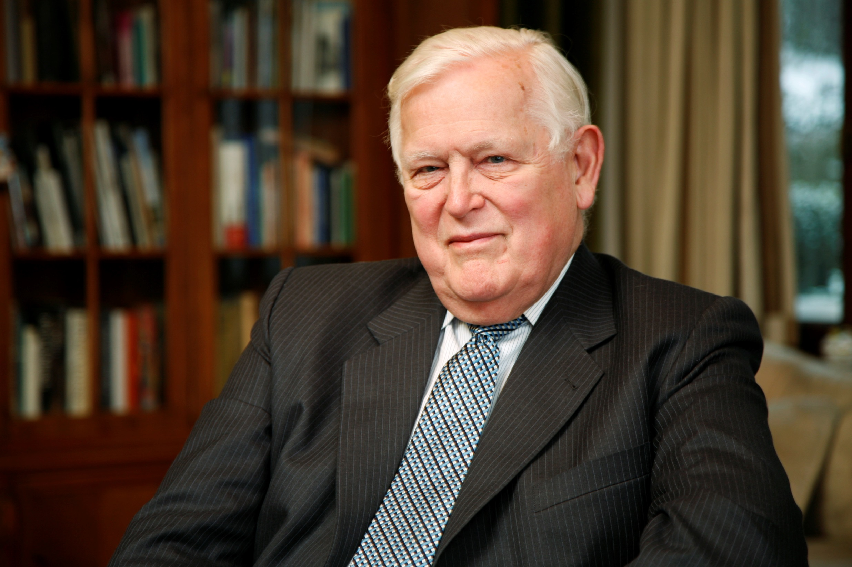
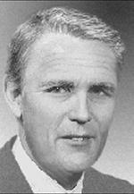
Kalman
Filter
Rudolf (Rudy) Emil Kálmán
May 19, 1930–
A Hungarian-American electrical engineer, mathematical system theorist
http://en.wikipedia.org/wiki/Rudolf_E._K%C3%A1lm%C3%A1n

Slide 6
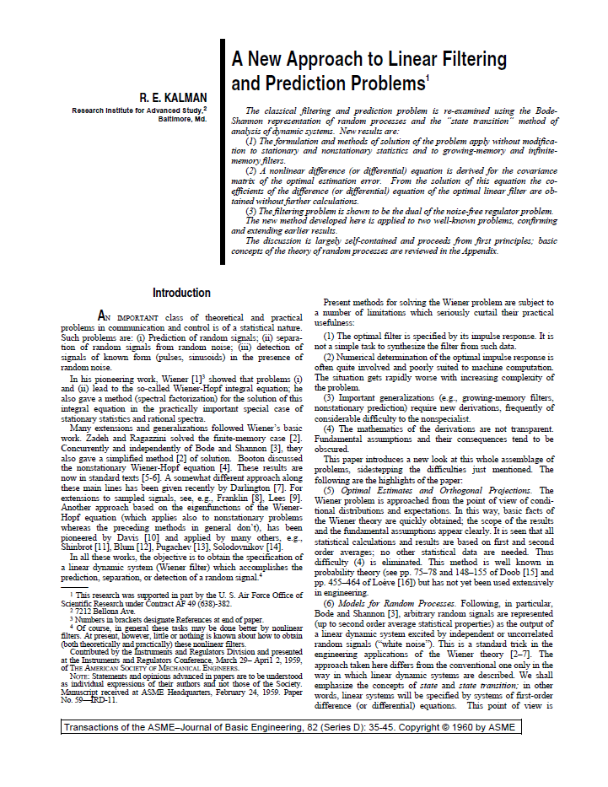
@article{
Author = {Kalman, Rudolph Emil},
Title = {A New Approach to Linear Filtering and Prediction Problems},
Journal = {Transactions of the ASME--Journal of Basic Engineering},
Volume = {82},
Number = {Series D},
Pages = {35--45},
Year = {1960} }

Slide 7
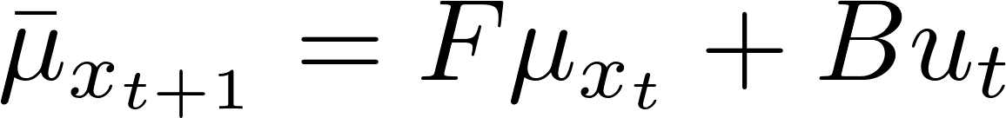
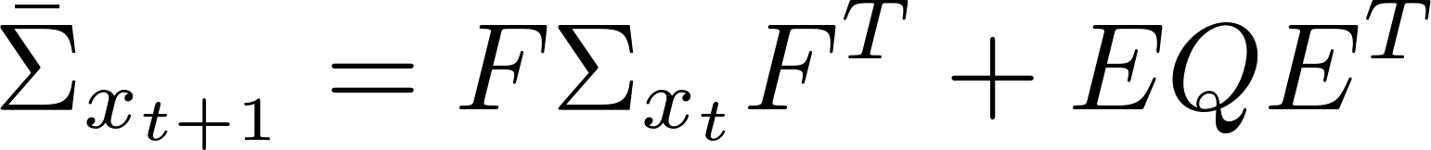
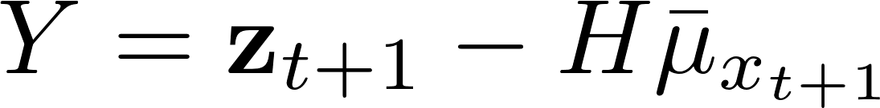
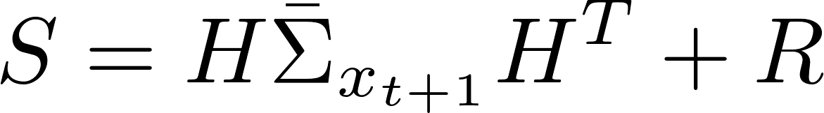
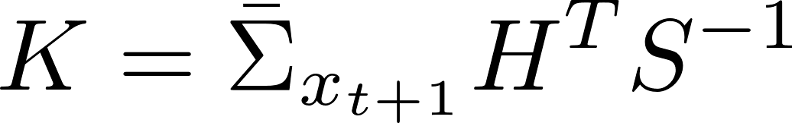

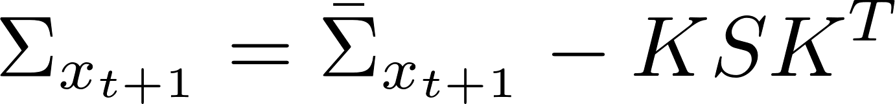
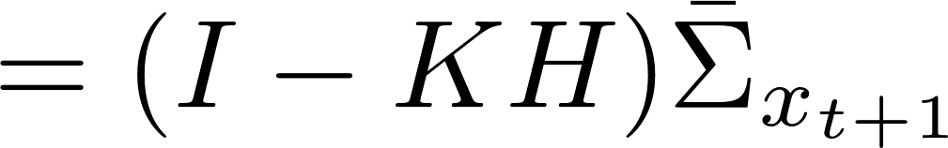
Prediction
Update
Innovation / Residual
Innovation variance
Kalman gain
Linear Kalman filter

Slide 8
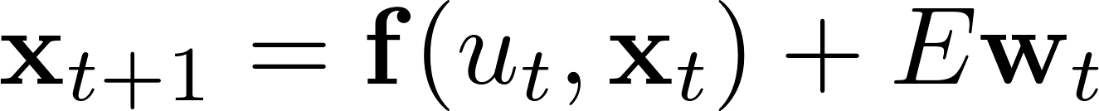
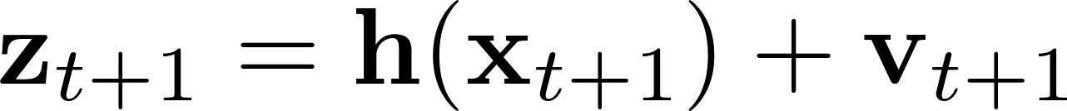
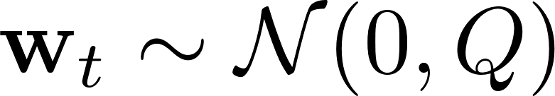
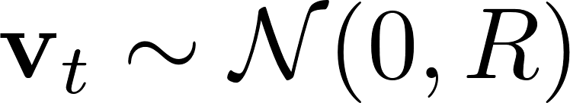

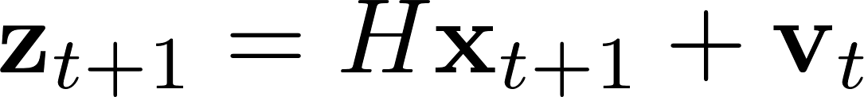
Linear models
Linear motion model
Linear sensor model

Slide 9
The assumptions that observation are linear functions of the state and that the next state is a linear function of the previous state are crucial for the correctness of a linear Kalman filter.
Linear assumption

Slide 10
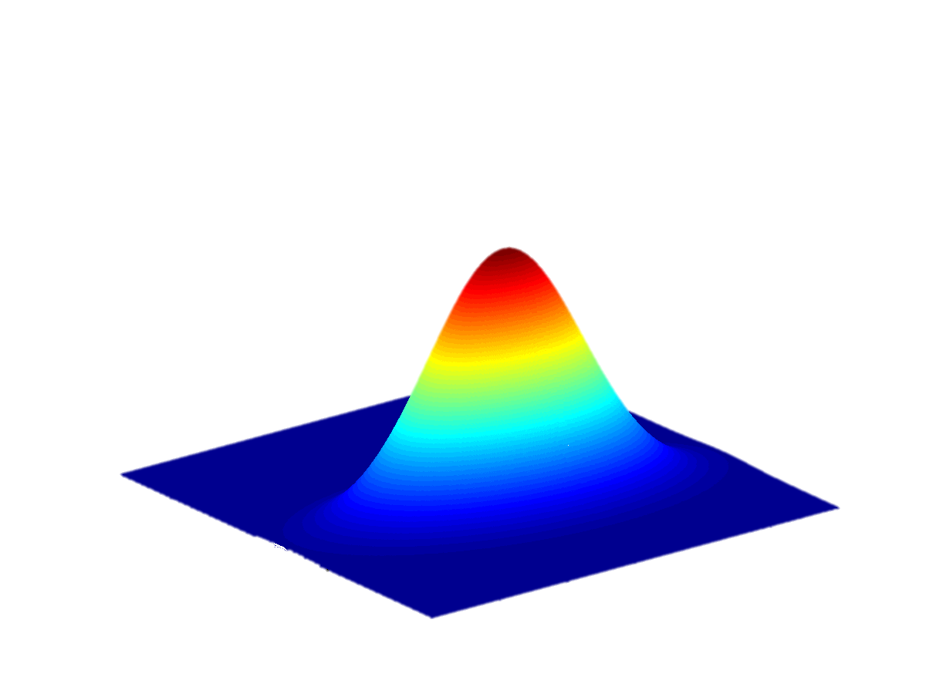
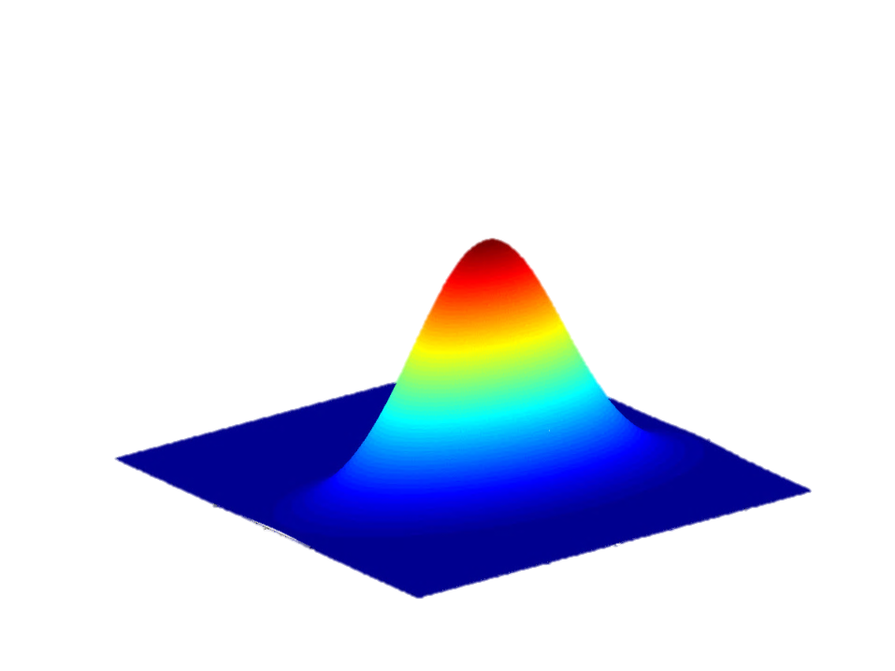
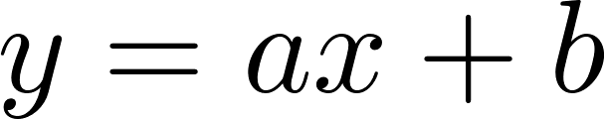

The linear transformation of a Gaussian random variable results in another Gaussian random variable.

Slide 11
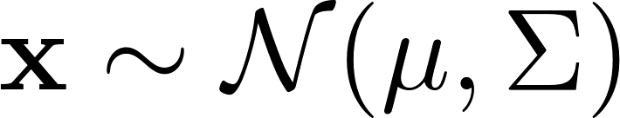
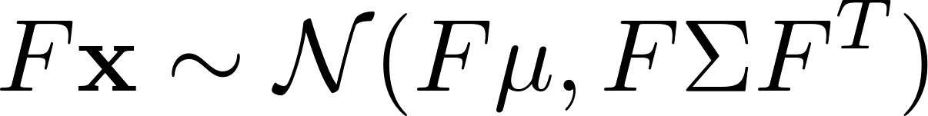
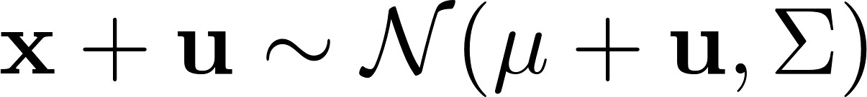
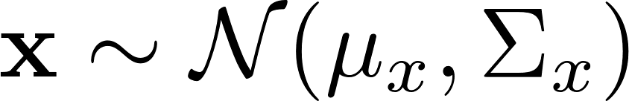
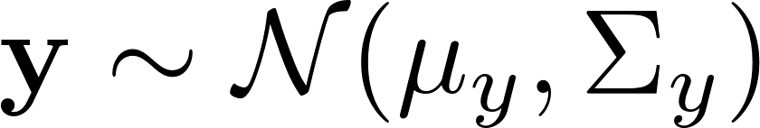
Nice properties of Gaussian distribution
ND

Slide 12
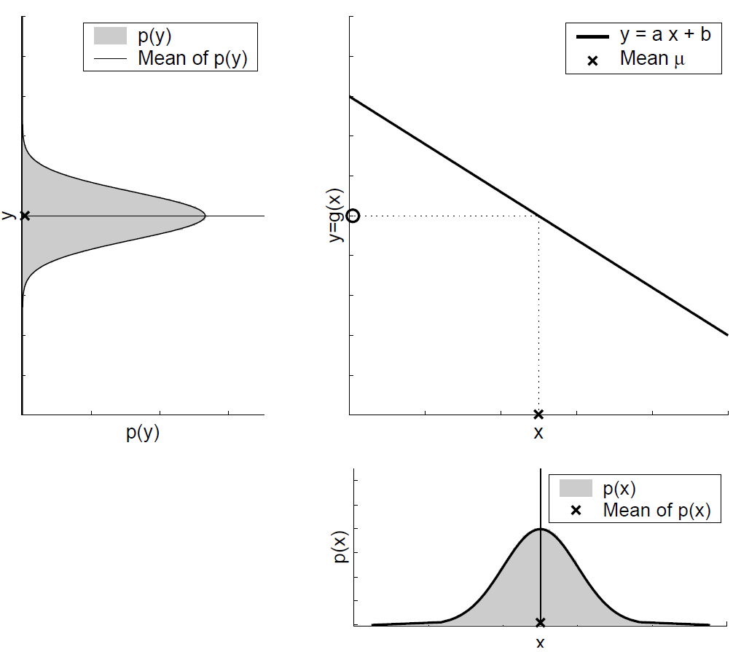

Slide 15
Is linear KF adequate for real applications?
NO!

Slide 16
General Nonlinear models
Nonlinear motion model
Nonlinear sensor model

Slide 17

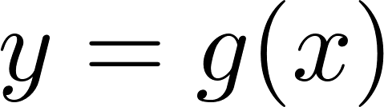
The Nonlinear transformation of a Gaussian results in …

Slide 18
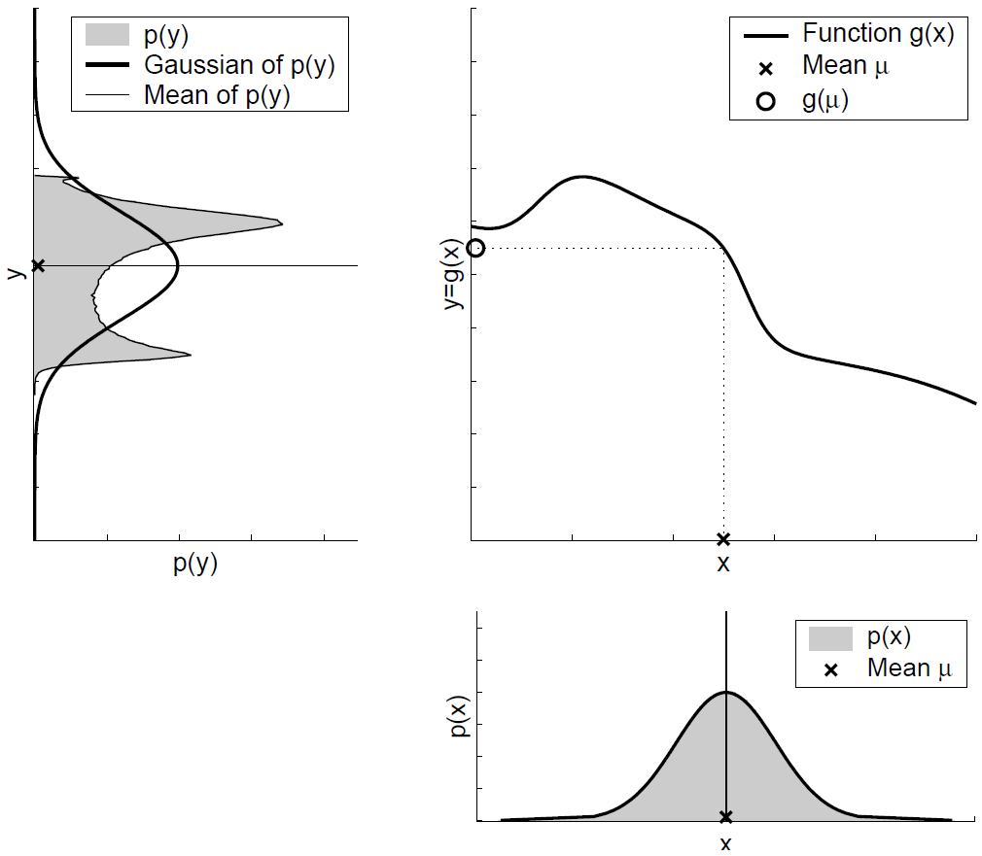

Slide 20

Expensive!

Slide 21
Prediction
Update
Innovation / Residual
Innovation variance
Kalman gain
Linear Kalman filter

Slide 22
To maintain the Gaussian assumption, We require the transition matrices, then the LKF formulas can be reused, but HOW…

Slide 23
Nonlinear
Linearization
Linear

Slide 24
From LKF to EKF

Slide 25
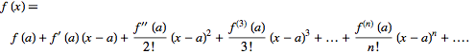
Taylor Expansion
A Taylor series is a series expansion of a function about a point. A one-dimensional Taylor series is an expansion of a real function f(x) about a point x=a is given by

Slide 26
Where should the f’ be evaluated?

Slide 27
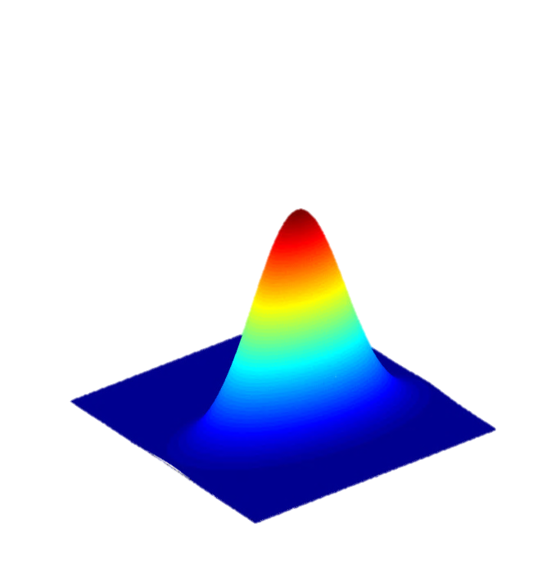
Mean + Covariance

Slide 28



Prediction
Linear Kalman filter

Slide 29
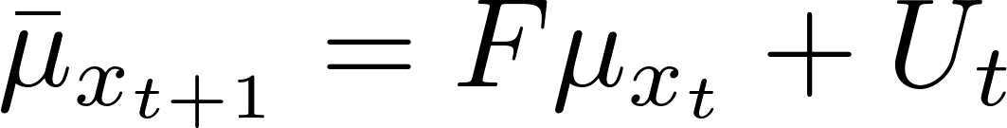
Prediction
Linear Kalman filter

Slide 30
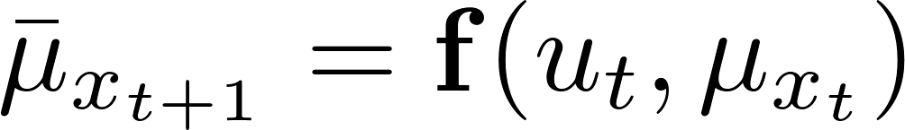
Prediction
Linear Kalman filter

Slide 31
Prediction
Linear Kalman filter

Slide 32
Prediction
Extended
Kalman filter

Slide 33
Mean + Covariance

Slide 34

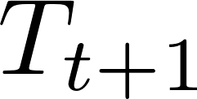
Linear Kalman filter

Slide 35
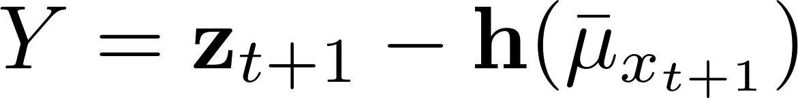
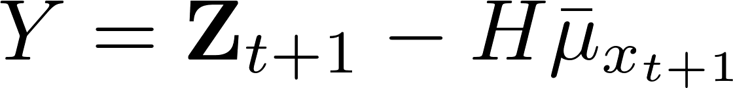
Linear Kalman filter

Slide 36
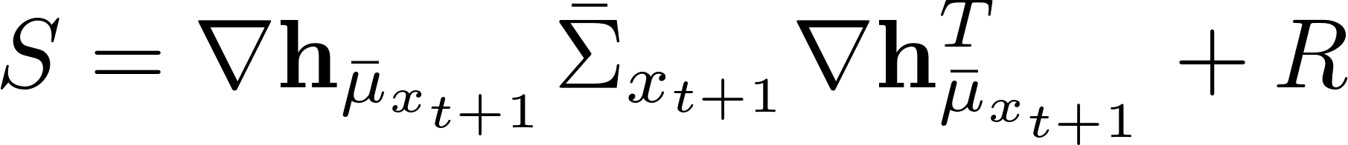
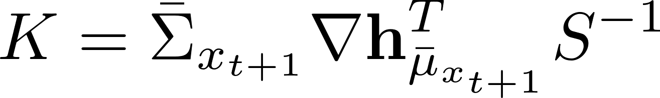
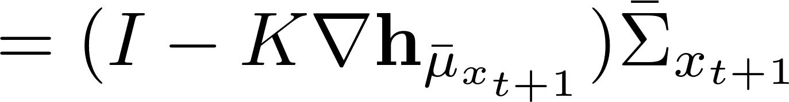
Prediction
Update
Innovation / Residual
Innovation variance
Kalman gain
Extended
Kalman filter

Slide 37
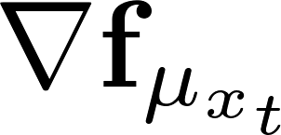
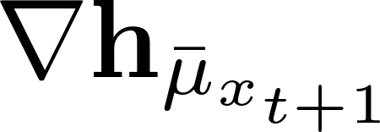
The Jacobian matrix of function f with respect to x evaluated at \mu_{x_t}
The Jacobian matrix of function h with respect to x evaluated at \bar{\mu}_{x_{t+1}}

Slide 38
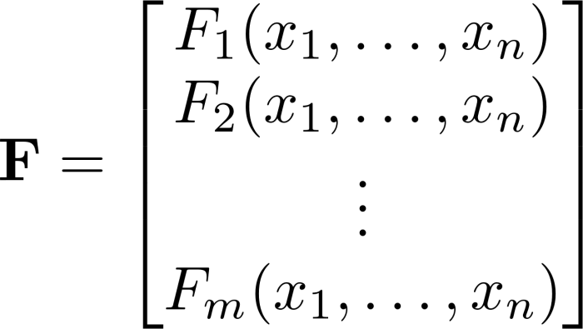
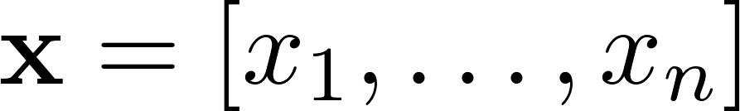
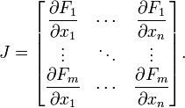
Jacobian matrix
In vector calculus, the Jacobian matrix is the matrix of all first-order partial derivatives of a vector-valued function.

Slide 39

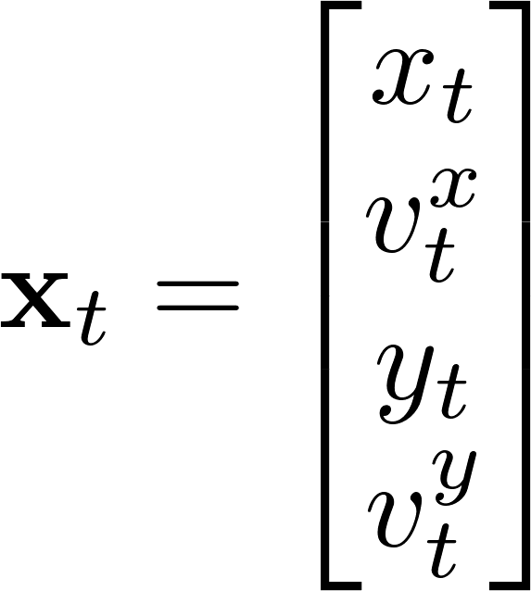
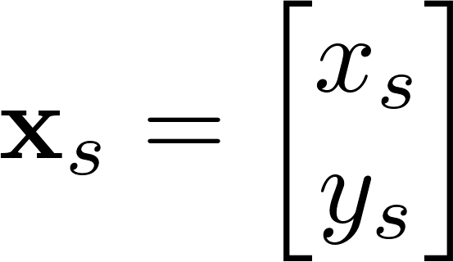

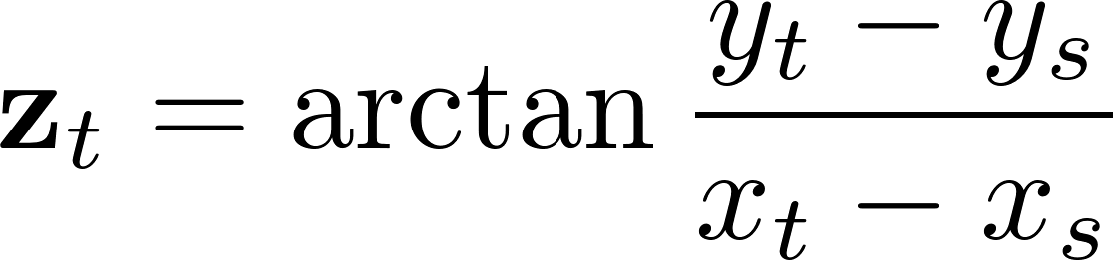
Bearing-only sensor

Slide 40
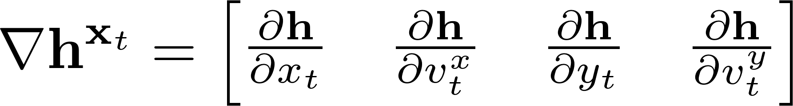
Calculate the Jacobian matrix of the following observation model w.r.t the state vector x:
Calculate it by programming!

Slide 41
syms x y vx vy xs ys
h = atan((y - ys) / (x - xs));
X = [x, vx, y, vy];
H = jacobian(h, X);
disp(H);
P48
[ -(y - ys)/((x - xs)^2*((y - ys)^2/(x - xs)^2 + 1)), 0, 1/((x - xs)*((y - ys)^2/(x - xs)^2 + 1)), 0]
Just build the function jacobH using the result.

Slide 42

function H = jacobH(Xs, X)
xs = Xs(1);
ys = Xs(2);
x = X(1);
y = X(2);
H = [ -(y - ys)/((x - xs)^2*((y - ys)^2/(x - xs)^2 + 1)), ...
0,...
1/((x - xs)*((y - ys)^2/(x - xs)^2 + 1)),...
0];
end
P49
Packages in Matlab
Namespace in C++
http://www.mathworks.cn/cn/help/matlab/matlab_oop/scoping-classes-with-packages.html
Packages Create Namespaces

Slide 43
Partial nonlinearity

Slide 44
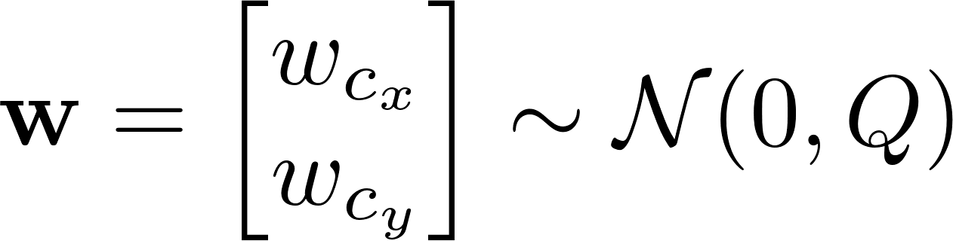
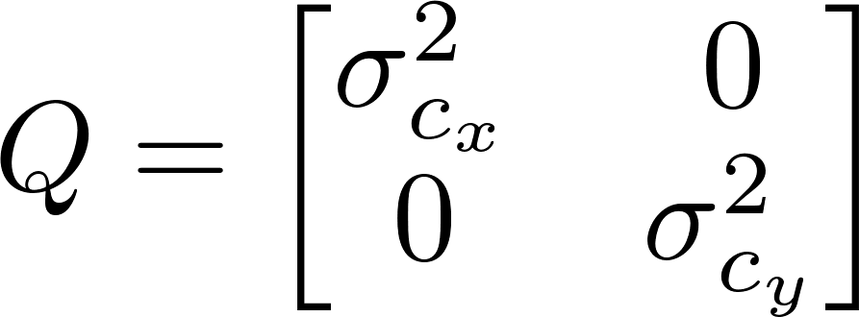
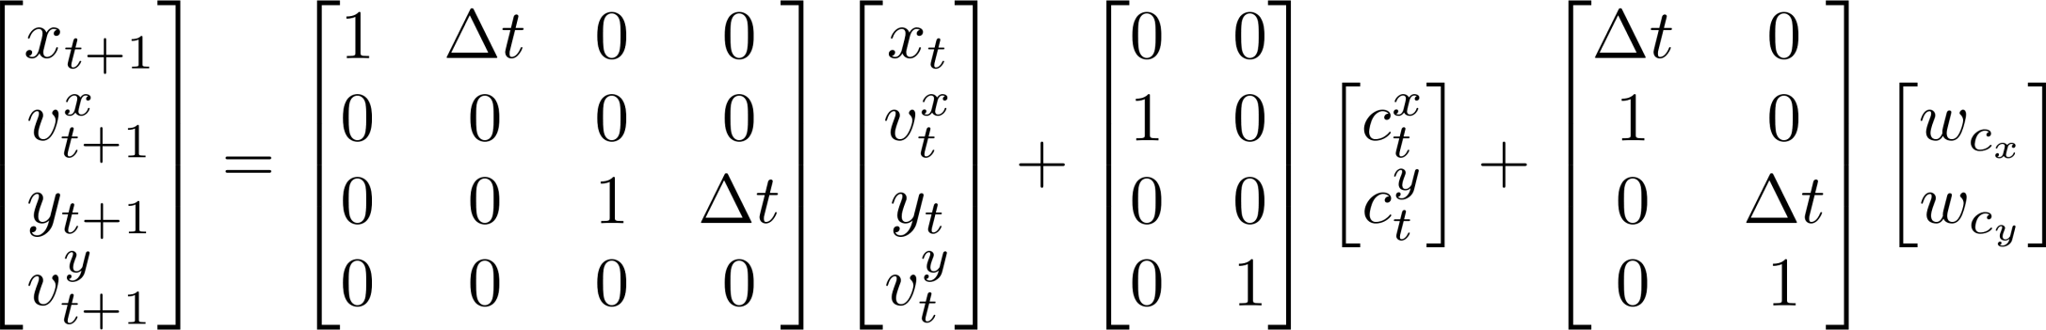
Motion model
linear
F
B
E

Slide 45
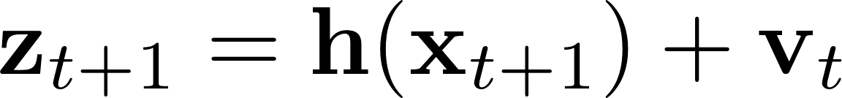
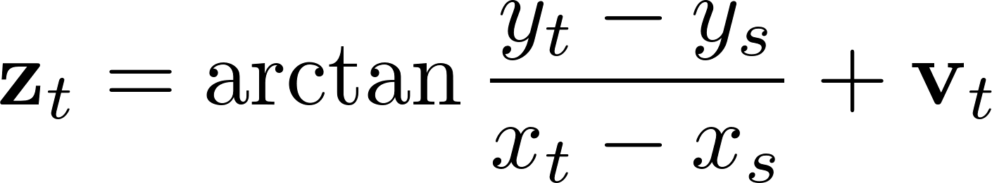

Measurement
model
nonlinear

Slide 46
function z = sensorModel(x, sensorPos)
z = atan((x(3)-sensorPos(2))/(x(1)-sensorPos(1)));
if (x(1) - sensorPos(1)) < 0
z = piTopi( z + pi);
end
end
Measurement
model

Slide 47
function z = sensorModel(x, sensorPos)
z = atan2( x(3)-sensorPos(2), x(1)-sensorPos(1) );
end
Measurement
model
atan2
Four-quadrant inverse tangent, it uses sign(Y) and sign(X) to determine the specific quadrant

Slide 48
Motion model
Sensor model

Slide 49
Prediction
linear
Update
Innovation / Residual
Innovation variance
Kalman gain
nonlinear

Slide 50

P49

Slide 51


Slide 52
for i = 1 : step
if i ~= 1
[mu, Sigma] = predictLKF(mu, Sigma, F, Q, ...
'processNoiseMat', E, 'controlMat', B,...
'control', u(:, i));
muPred(:,i) = mu;
SigmaPred(:,:,i) = Sigma;
end
H = p49.jacobH(mu, sensorPos);
[mu, Sigma, innov(:,i), SigmaInnov(:,:,i)] =...
updateEKF(mu, Sigma, @p49.sensorModel, sensorPos,...
zTrue(:,i), H, R, true, 1);
muPost(:,i) = mu;
SigmaPost(:,:,i) = Sigma;
end
P49

Slide 53
function [muPost, SigmaPost, Y, S, K] = updateEKF(mu, Sigma,...
sensorModel, sensorPos, z, H, R, hasAngle, idxAngle)
%%
if nargin < 8
hasAngle = false;
end
if nargin == 8
idxAngle = length(z);
end
%%
Y = z - sensorModel(mu, sensorPos);
if hasAngle
Y(idxAngle) = piTopi(Y(idxAngle));
end
S = H * Sigma * H' + R;
K = Sigma * H' / S;
muPost = mu + K * Y;
SigmaPost = Sigma - K * S * K';
end
P49

Slide 54

KF Demo with sonar
http://veterobot.com/
An open sourced and 3D printed robot

Slide 55
0=2pi problem

Slide 56
Prediction
Update
Innovation / Residual
Innovation variance
Kalman gain
Extended
Kalman filter

Slide 57
Innovation / Residual
It is tricky if the measurement vector contains angles

Slide 58




Slide 59
No! the angle A and B are actually very close, since 0=2pi.

Slide 60


Correct solution:

Slide 61





Slide 62


Slide 63
function angle = piTopi(angle)
% Input: array of angles.
% Output: normalised angles.
% Tim Bailey 2000, modified 2005.
% Samuel modifies it to bound the angle at
% [-pi, pi).
twopi = 2*pi;
angle = angle - twopi*fix(angle/twopi); % this is a stripped-down version of rem(angle, 2*pi)
i = find(angle >= pi); % Samuel modifies.
angle(i) = angle(i) - twopi;
i = find(angle < -pi);
angle(i) = angle(i) + twopi;
end

Slide 64


Slide 65
General solution to 0=2pi problem
Always bound the resulting angles using function piTopi.

Slide 66

Version SHA-1: ee267033a0
%% Process noise sigma
sigmaCxNoise = 0.02;
sigmaCyNoise = 0.02;
%% Measurement noise sigma
sigmaBNoise = degtorad(0.09);
P50

Slide 67

Version SHA-1: ee267033a0
%% Process noise sigma
sigmaCxNoise = 0.02;
sigmaCyNoise = 0.02;
%% Measurement noise sigma
sigmaBNoise = degtorad(0.09);

Slide 68

Version SHA-1: ee267033a0
%% Process noise sigma
sigmaCxNoise = 0.02;
sigmaCyNoise = 0.02;
%% Measurement noise sigma
sigmaBNoise = degtorad(0.09);

Slide 69


Slide 70
Fully nonlinear demo

Slide 71

Motion model

Slide 72








Motion model

Slide 73





Motion model

Slide 74

Motion model

Slide 75
Jacobian matrix
In vector calculus, the Jacobian matrix is the matrix of all first-order partial derivatives of a vector-valued function.

Slide 77


Slide 78


Slide 79


Slide 80


Slide 81


Slide 82


Slide 83


Slide 84


Slide 85


Slide 86


Slide 87
Motion model
nonlinear

Slide 88


Motion model
nonlinear

Slide 89
Measurement
model
nonlinear
Calculate the Jacobians by programming!

Slide 90
syms x y theta dx dy dtheta xs ys;
f = [dx * cos(theta) - dy * sin(theta) + x;
dy * cos(theta) + dx * sin(theta) + y;
dtheta + theta];
X = [x, y, theta];
F = jacobian(f, X);
disp(F);
simplify(F)
%%
h = atan((y - ys) / (x - xs));
H = jacobian(h, X);
disp(H);
simplify(H)
P52
[ 1, 0, - dy*cos(theta) - dx*sin(theta)]
[ 0, 1, dx*cos(theta) - dy*sin(theta)]
[ 0, 0, 1]
[ -(y - ys)/((x - xs)^2*((y - ys)^2/(x - xs)^2 + 1)),
1/((x - xs)*((y - ys)^2/(x - xs)^2 + 1)),
0]

Slide 91
Construct the Jacobian matrix calculating function based on the syms formulas.
[ 1, 0, - dy*cos(theta) - dx*sin(theta)]
[ 0, 1, dx*cos(theta) - dy*sin(theta)]
[ 0, 0, 1]
[ -(y - ys)/((x - xs)^2*((y - ys)^2/(x - xs)^2 + 1)),
1/((x - xs)*((y - ys)^2/(x - xs)^2 + 1)),
0]

Slide 92
P54/+p54/jacobF
function F = jacobF(X, u)
theta = X(3);
dx = u(1);
dy = u(2);
F = [1, 0, - dy*cos(theta) - dx*sin(theta);
0, 1, dx*cos(theta) - dy*sin(theta);
0, 0, 1];
end
[ 1, 0, - dy*cos(theta) - dx*sin(theta)]
[ 0, 1, dx*cos(theta) - dy*sin(theta)]
[ 0, 0, 1]

Slide 93
P54/+p54/jacobH
function H = jacobH(X, Xs)
xs = Xs(1);
ys = Xs(2);
x = X(1);
y = X(2);
H = [ -(y - ys)/((x - xs)^2*((y - ys)^2/(x - xs)^2 + 1)), ...
1/((x - xs)*((y - ys)^2/(x - xs)^2 + 1)), ...
0];
end
[ -(y - ys)/((x - xs)^2*((y - ys)^2/(x - xs)^2 + 1)),
1/((x - xs)*((y - ys)^2/(x - xs)^2 + 1)),
0]

Slide 94
The robot motion has been implemented in p25.
P53 simulates the bearing only observation based on the motions.
P53

Slide 95

P53

Slide 96

P54

Slide 97
P54
A general function predictEKF is constructed and the updateEKF produced for the partial nonlinear demo is reused here. To understand tricks employed in visualization sections, please study Matlab help documents. The programming style, variable structures and most of the codes can be reused in your future applications.

Slide 98
The results are produced by the version (SHA-1: a3f036df, Date: 2013/6/13) in the git repository
P55
%% Tune noises
proNoiseScalar = 1.0;
obsNoiseScalar = 1.0;
%% Process noise sigma
sigmaXNoise = 0.00001;
sigmaYNoise = 0.00001;
sigmaThetaNoise = degtorad(0.0001);
Q = diag(proNoiseScalar * ...
[sigmaXNoise, sigmaXNoise, sigmaXNoise]).^2;

Slide 99

The results are produced by the version (SHA-1: a3f036df, Date: 2013/6/13) in the git repository

Slide 100

The results are produced by the version (SHA-1: a3f036df, Date: 2013/6/13) in the git repository

Slide 101

The results are produced by the version (SHA-1: a3f036df, Date: 2013/6/13) in the git repository

Slide 102
P55
The above three figures depict the consistency validation results with the approaches designed for linear Kalman filter. Something might be wrong here. Please revalue the performance and study related references, then get the elegant methods, suitable model configurations or (and) reasonable interpretations for the demo’s consistency.

Slide 103

Yes. Bugs do exist in the version before SHA-1: a3f036df. The Jacobian matrix used in prediction was definitely wrong!

Slide 104


Slide 105


Slide 106


Slide 107
P55
Please note that the linearization itself introduces error, so the estimation deviation is not zero even if noises are set to zero.

Slide 108
EKF Demo with Bearing & range

Slide 109
Motion model
nonlinear

Slide 110
Motion model
nonlinear

Slide 111

Measurement
model
nonlinear
Calculate the Jacobians by programming!

Slide 112
syms x y theta xs ys;
X = [x y theta];
%%
h = [atan((y - ys) / (x - xs)),...
sqrt((x-xs)^2 + (y-ys)^2)];
H = jacobian(h, X);
disp(H);
simplify(H)
P56
[ -(y - ys)/((x - xs)^2*((y - ys)^2/(x - xs)^2 + 1)), 1/((x - xs)*((y - ys)^2/(x - xs)^2 + 1)), 0]
[ (2*x - 2*xs)/(2*((x - xs)^2 + (y - ys)^2)^(1/2)), (2*y - 2*ys)/(2*((x - xs)^2 + (y - ys)^2)^(1/2)), 0]
[ -(y - ys)/((x - xs)^2*((y - ys)^2/(x - xs)^2 + 1)), 1/((x - xs)*((y - ys)^2/(x - xs)^2 + 1)), 0]
[ (x - xs)/((x - xs)^2 + (y - ys)^2)^(1/2), (y - ys)/((x - xs)^2 + (y - ys)^2)^(1/2), 0]
simplified

Slide 113

P57

Slide 114

P58

Slide 115

P58

Slide 116

P58

Slide 117
KF for more general models

Slide 118



Motion model
Sensor model

Slide 119
Motion model
Sensor model

Slide 120
Prediction
Update
Innovation / Residual
Innovation variance
Kalman gain
Linear Kalman filter

Slide 121
Motion model
Sensor model

Slide 122

Prediction
Update
Innovation / Residual
Innovation variance
Kalman gain
Linear Kalman filter

Slide 123
Motion model
Sensor model

Slide 124
Prediction
Update
Innovation / Residual
Innovation variance
Kalman gain
Extended
Kalman filter

Slide 125
Motion model
Sensor model

Slide 126


Prediction
Update
Innovation / Residual
Innovation variance
Kalman gain
Extended
Kalman filter

Slide 127


The Jacobian matrix of function f with respect to x evaluated at \mu_{x_t}
The Jacobian matrix of function h with respect to x evaluated at \bar{\mu}_{x_{t+1}}
The Jacobian matrix of function f with respect to w evaluated at \mu_{x_t}
The Jacobian matrix of function h with respect to v evaluated at \bar{\mu}_{x_{t+1}}

Slide 128
Bottlenecks of EKF

Slide 129
EKF approximates state transitions and measurements using Taylor expansions, The goodness of the linear approximation depends on two main factors:
The degree of uncertainty
The degree of local nonlinearity of the functions that are being approximated.

Slide 130


Slide 131


Slide 132
Higher uncertainty typically results in less accurate estimates of the mean and covariance of resulting random variable.

Slide 133


Slide 134


Slide 135
Higher nonlinearities result in larger approximation errors.

